Slide 1
Logika Basics
STRESS 2024 – October 24, 2024
Kansas State University
Aarhus University
Robby
John Hatcliff
Jason Belt
Stefan Hallerstede
This material is based on research sponsored in part by DARPA
DISCLAIMER: The views and conclusions contained in this presentation are those of the author and should not be interpreted as representing the official policies, either express or implied, of any agency or department of the U.S. Government, Kansas State University or Aarhus University
Notes:
I'm John Hatcliff, a professor from Kansas State University. This is a second talk on semantics for a modeling language, and here we aim to make deeper connections with the underlying application and infrastructure code via contracts. This talk pulls together several different lines of work that were carried out in collaboration with different teams, including teams from SEI and Galois primarily, but always folks from Collins Aerospace and people working on seL4.

Slide 2
Logika interface Basics

Slide 3
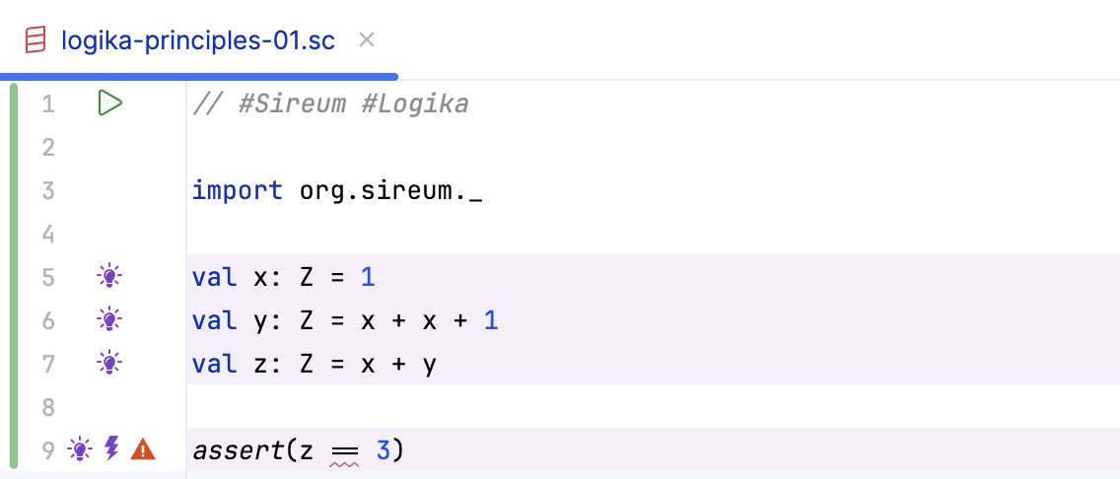
Verification Coverage
Logika highlights in a light purple color the statements that it has processed in a verification pass.
Verification coverage

Slide 4
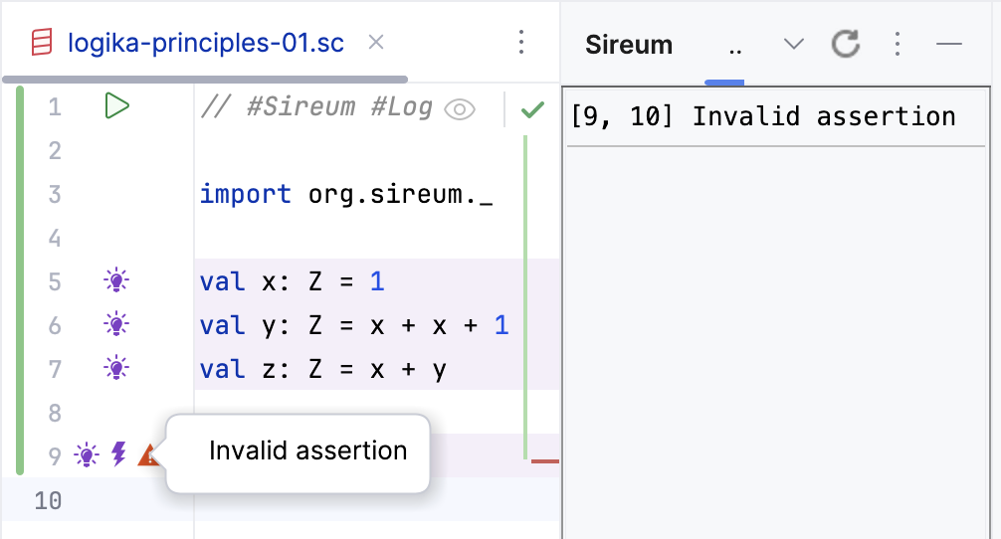
Verification Problems
Problem markers and red squiggles mark verification failures in code.
Clicking on a problem marker brings up more information
Hovering on a marker shows a tool tip with more information

Slide 5
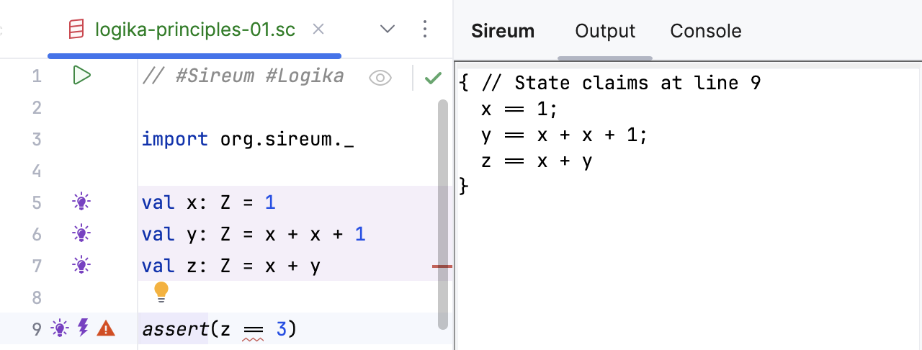
Bulb: Shows Facts
Logika works in a forwards direction and accumulates facts based on the statements and specifications that it encounters
The fact set representing the pre-state of line 9
Clicking on the light bulb annotation shows the current fact set (before the current statement is executed). In this case, we are displaying the pre-state of the statement at line 9.

Slide 6
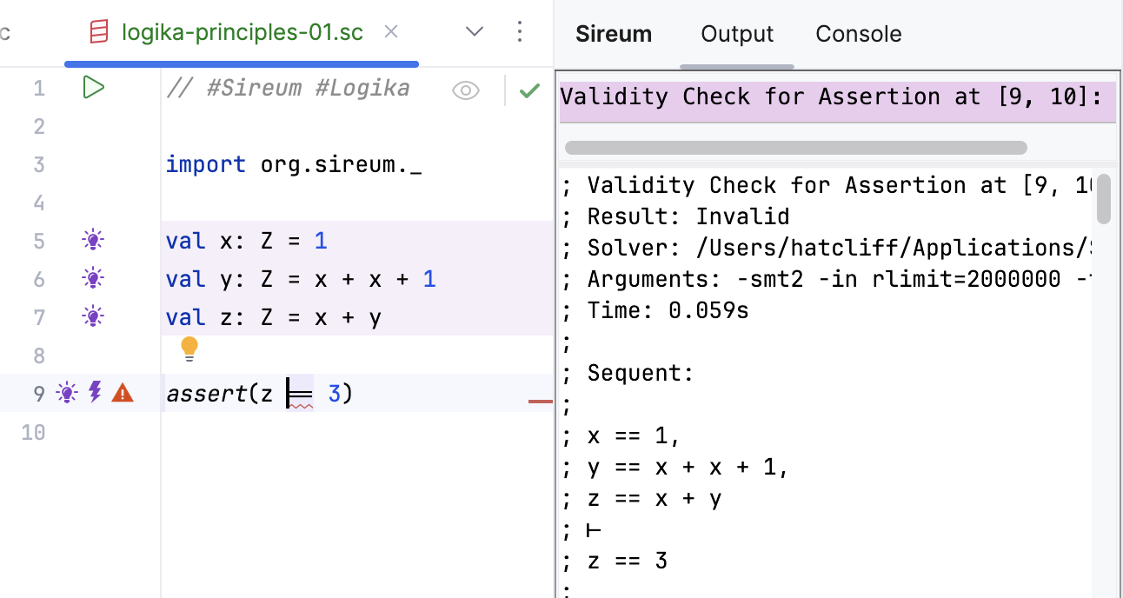
Bolt: Shows Summonings
At certain points in the verification process, Logika consults SMT solvers to make an automated deduction. This is referred to as “summoning” the SMT solvers.
The type of verification condition being checked by the summoning
The status of the verification condition (Valid, Invalid, Don’t Know, Timeout)
High-level representation of the verification condition as a sequent
Clicking on the lightning bolt annotation shows information about the summoning
Current fact set is the antecedent
Claim to prove is the consequent

Slide 7
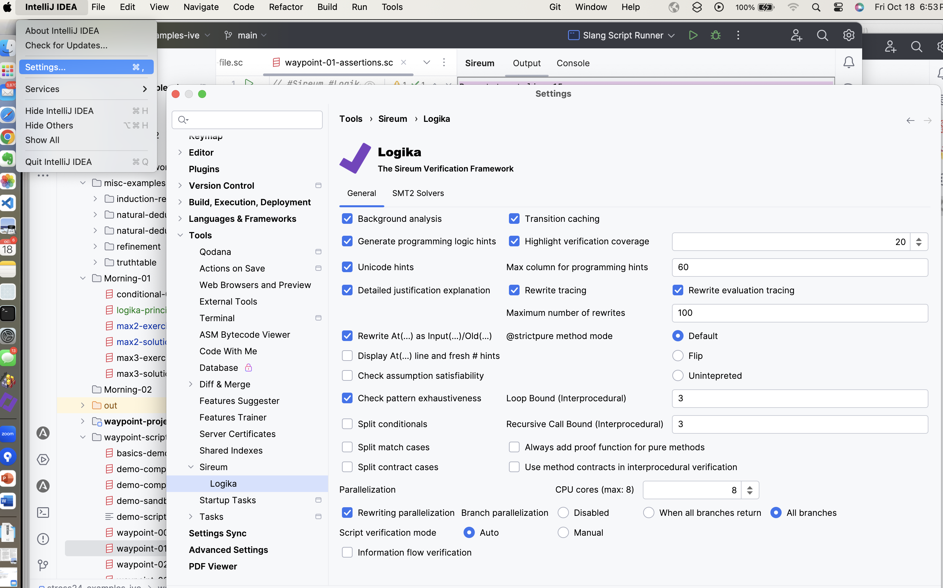
Logika Settings / Preferences
Background Analysis
Settings
Tools
Sireum / Logika
…by default Background analysis (”always on”) verification is set

Slide 8
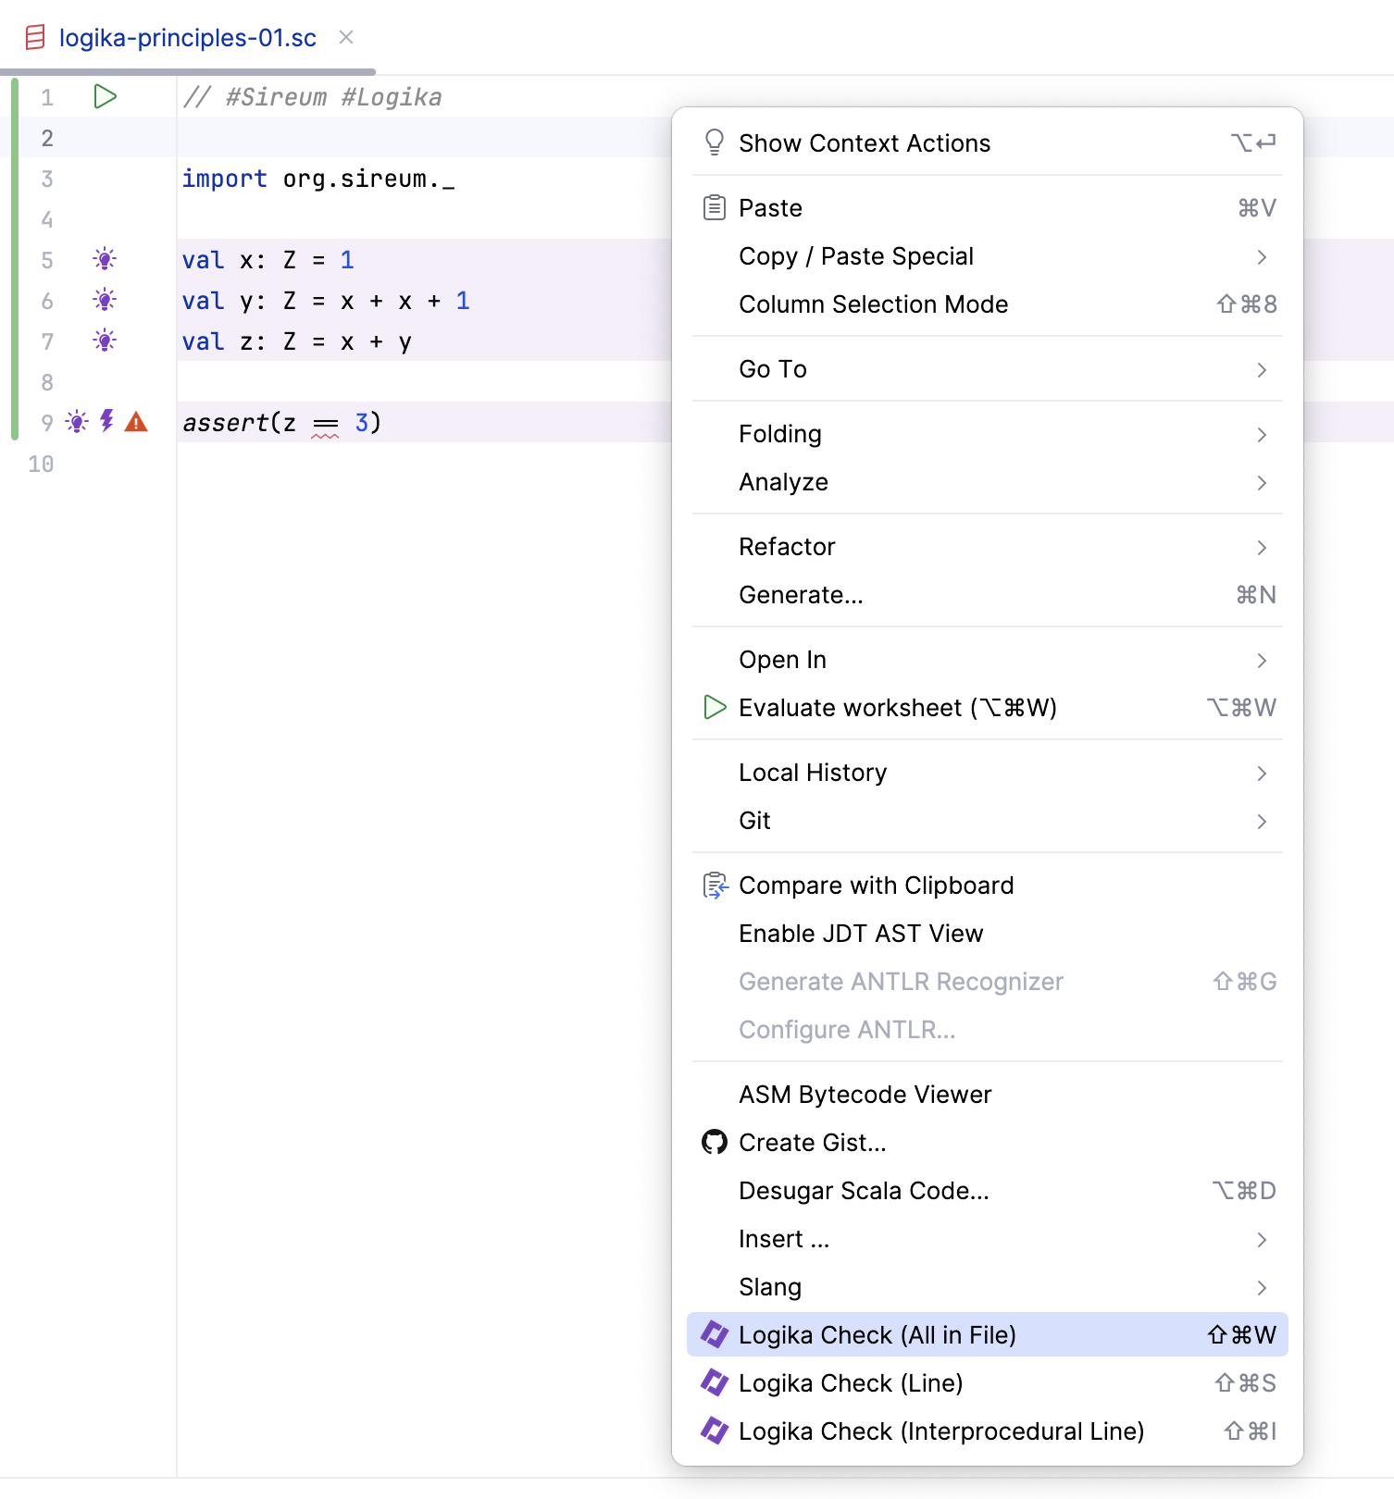
Manually Starting Verification
The context menu (“right click”) provides options for starting verification. For our activities, “All in File” is a good option.

Slide 9
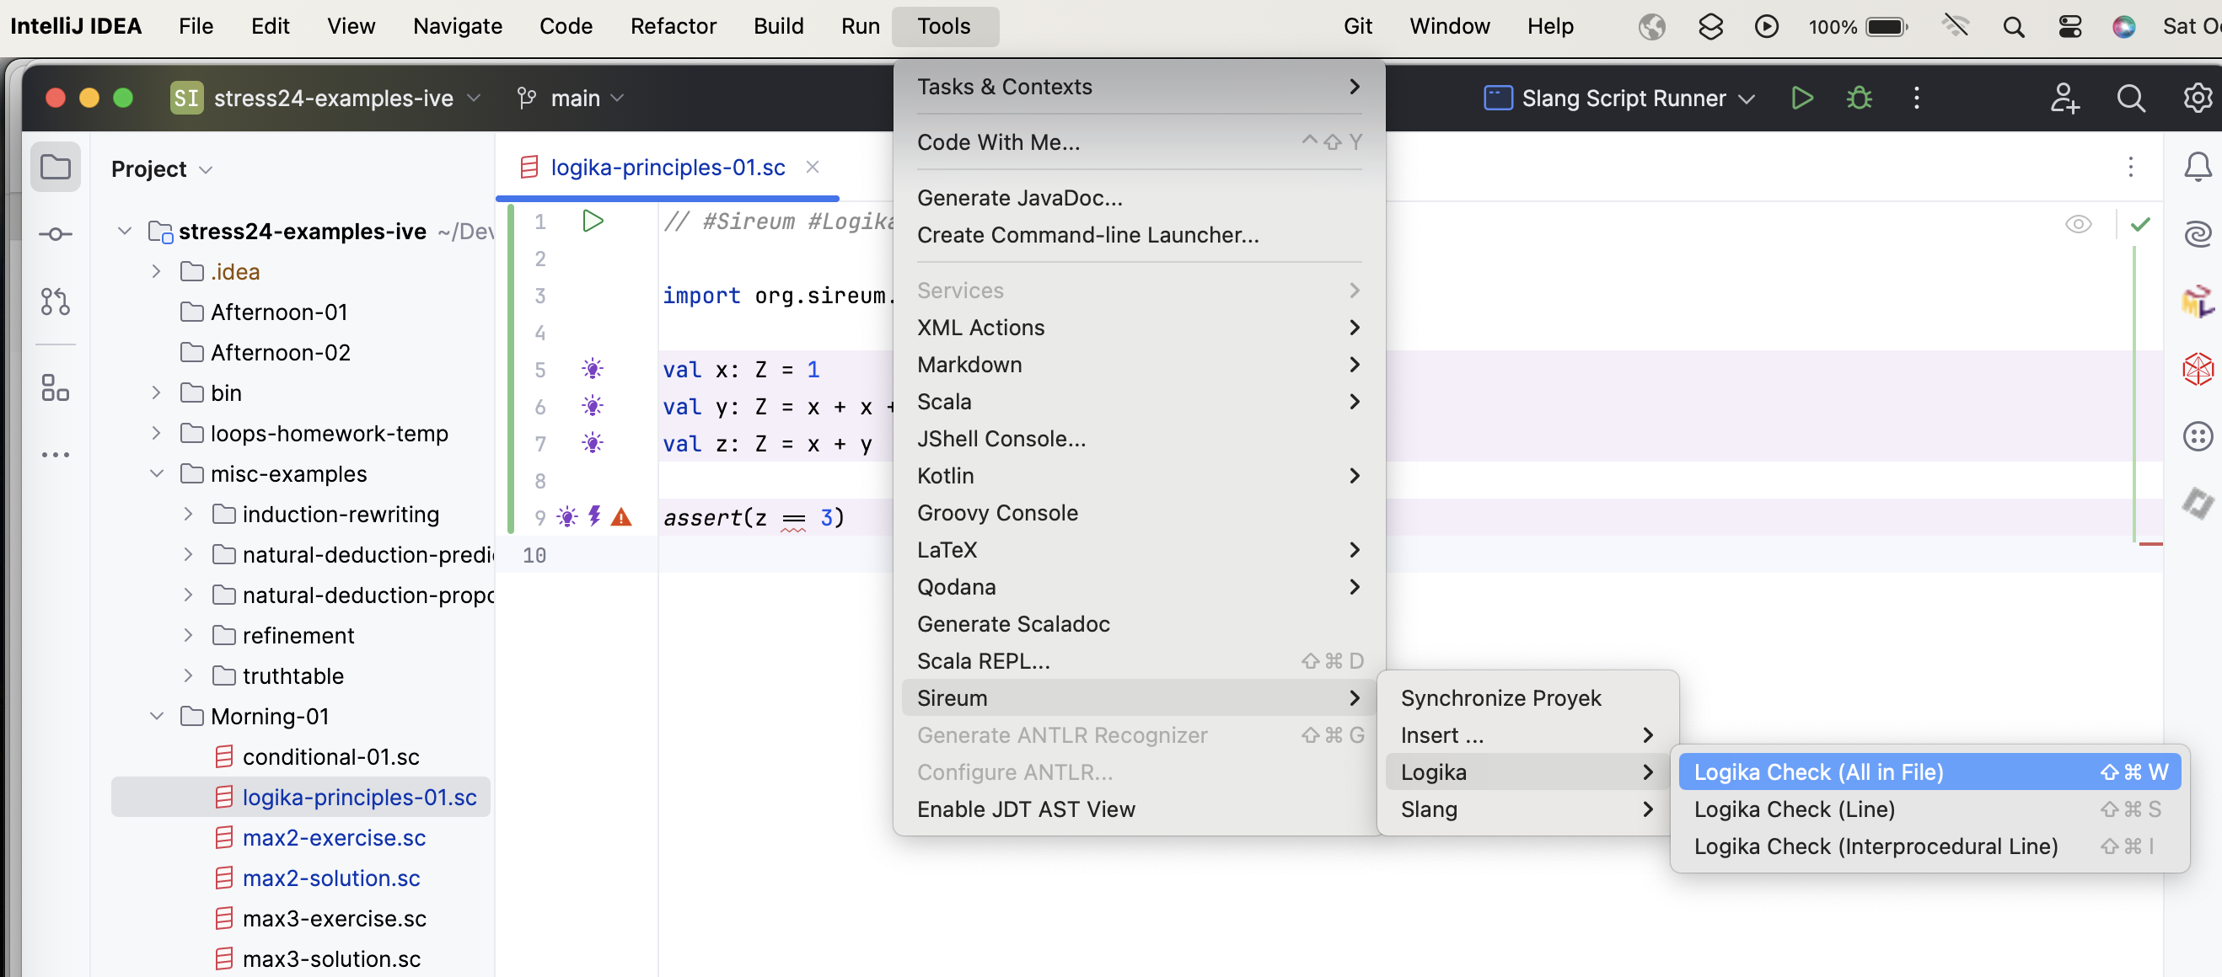
Manually Starting Verification
..or you can navigate to the Sireum / Logika options from the main menu bar (Tools /Sireum / Logika)

Slide 10
Variables

Slide 11
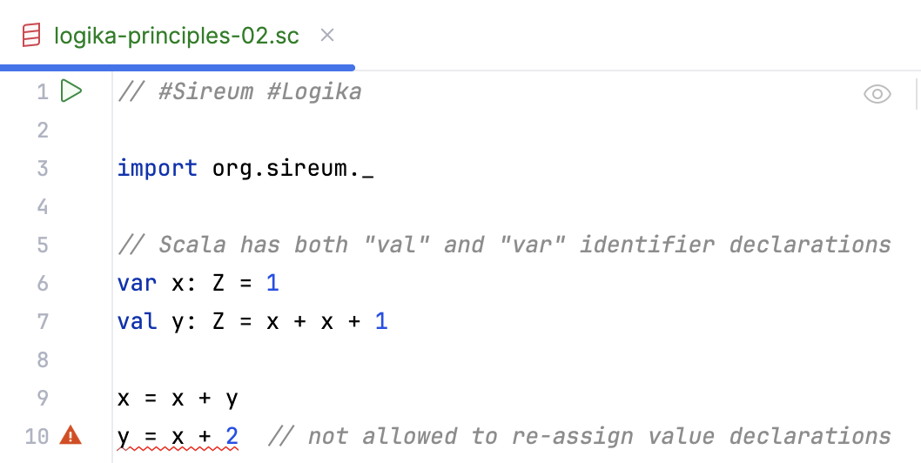
Var & Val Identifiers
Scala has both val and var identifiers. Both must be given a value when declared. Val identifiers cannot be reassigned.
Val identifiers cannot be reassigned

Slide 12
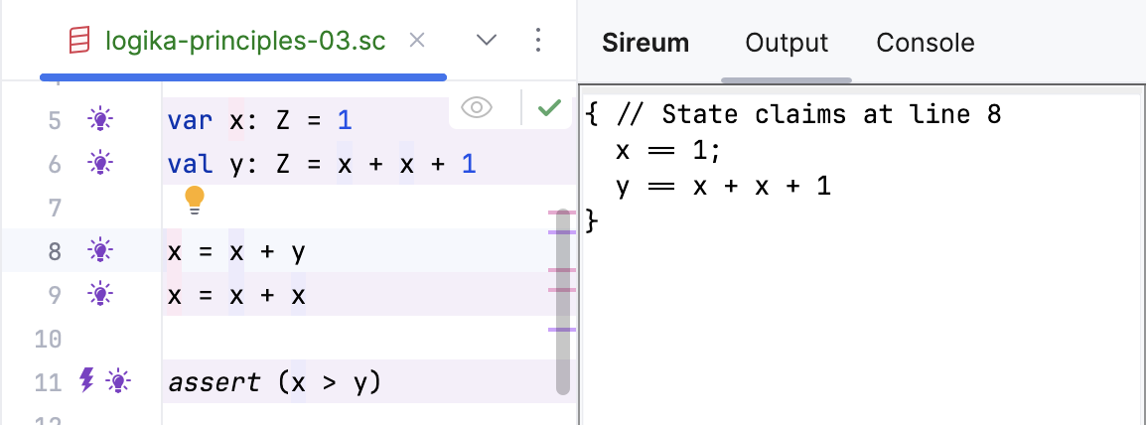
Logika Reasoning About Vars
As Logika reasons in a forward direction, it introduces a new symbolic value for a var each time it is assigned. It uses several developer-friendly strategies to name previous versions of a var’s value.
Before x is re-assigned, the variable name is used.

Slide 13
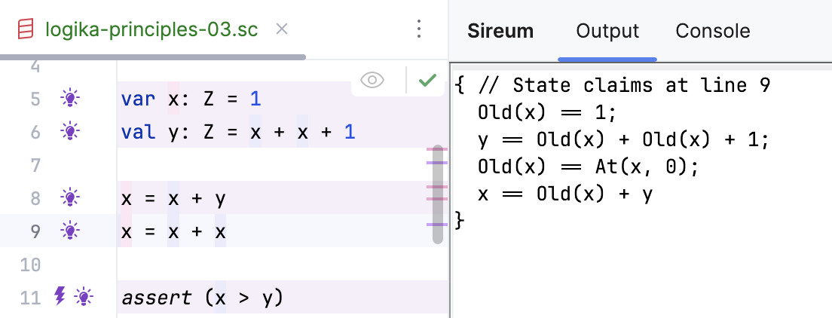
Logika Reasoning About Vars
As Logika reasons in a forward direction, it introduces a new symbolic value for a var each time it is assigned. It uses several developer-friendly strategies to name previous versions of a var’s value.
Also, At(x,n) refers to the n’th assignment occurrence of x
After x is re-assigned, the Old(x) refers to the previous value of x.

Slide 14
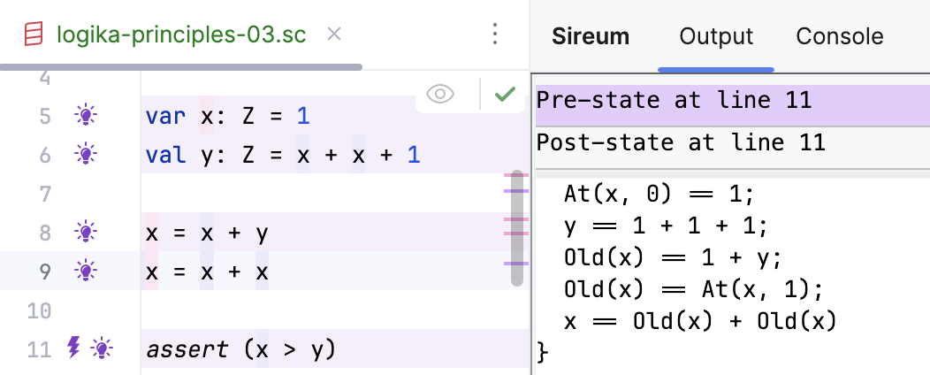
Logika Reasoning About Vars
As Logika reasons in a forward direction, it introduces a new symbolic value for a var each time it is assigned. It uses several developer-friendly strategies to name previous versions of a var’s value.
At(x,0)
At(x,1)
Old(x)
x has three different values in the history of the control flow
x

Slide 15
Conditional Statements

Slide 16
Schema for Reasoning About Conditional Statements
Logika uses the following principles for reasoning about conditional statements…
If execution enters the true branch, we know B must hold. So add B to the current fact set.
if (B) {
// V-Know: B
S
// ... F_{S}
} else {
// V-Know: !B
T
// ... F_{T}
}
// V-Know: B ->: F_{S} & !B -> F_{T}
Let’s say that after S, we have some additional facts F_{S} based on the execution of S
If execution enters the false branch, we know B must hold. So add B to the current fact set.
Let’s say that after T, we have some additional facts F_{T} based on the execution of T
At the end the conditional, conditional facts are added to the fact set – indicating the condition in which they hold

Slide 17
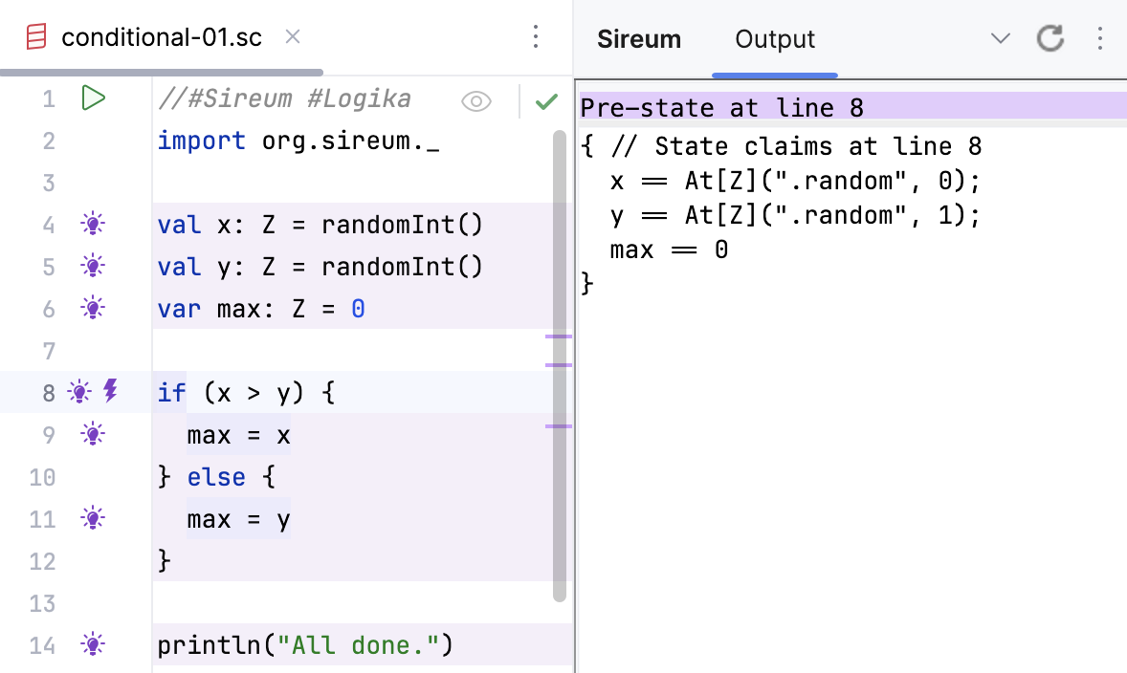
Conditionals: Step by Step
Fact set before entering the conditional

Slide 18
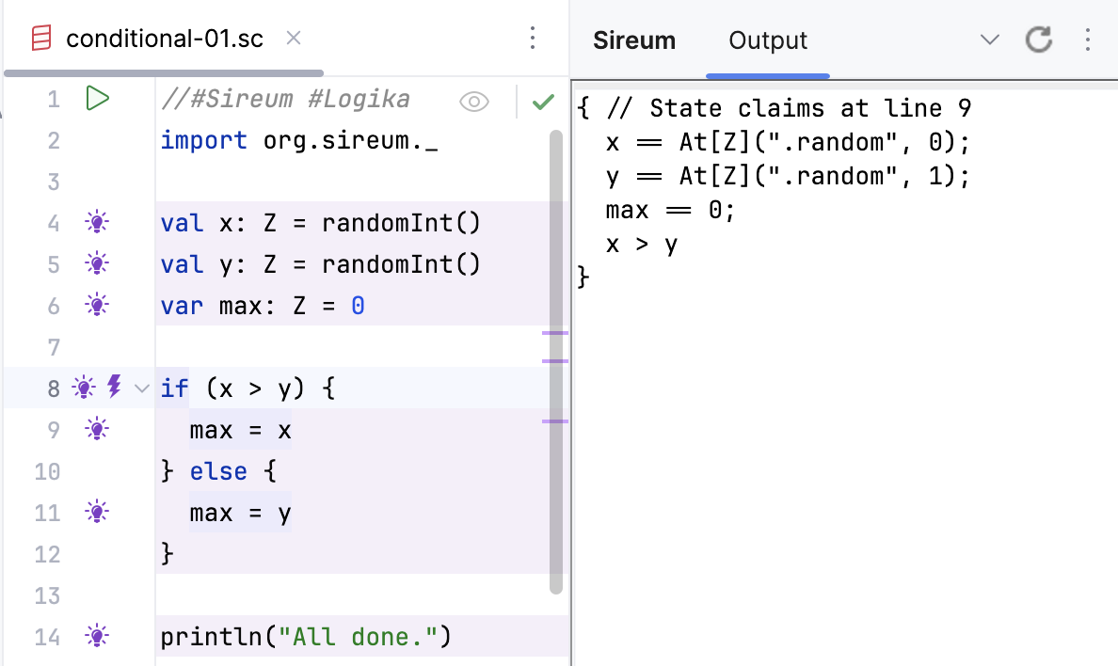
Conditionals: Step by Step
B
V-Know B: x > y is added to the fact set

Slide 19
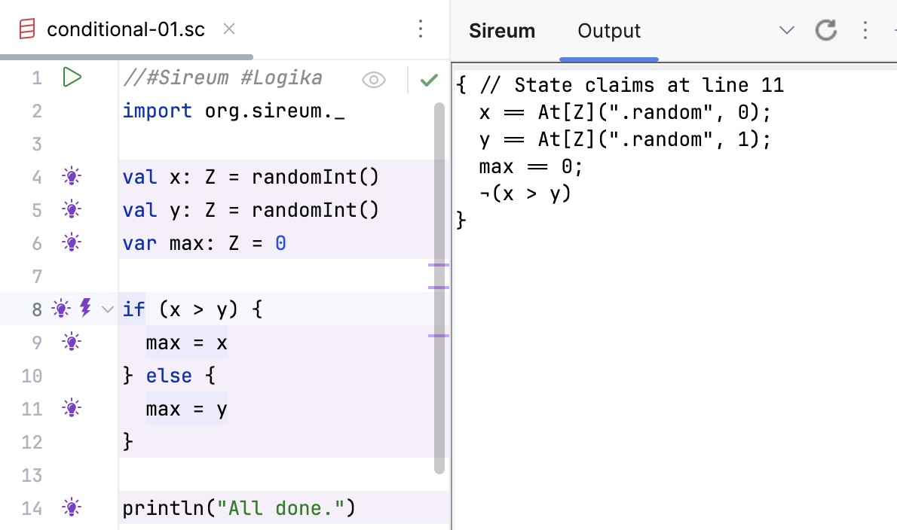
Conditionals: Step by Step
B
V-Know !B: !(x > y) is added to the fact set

Slide 20
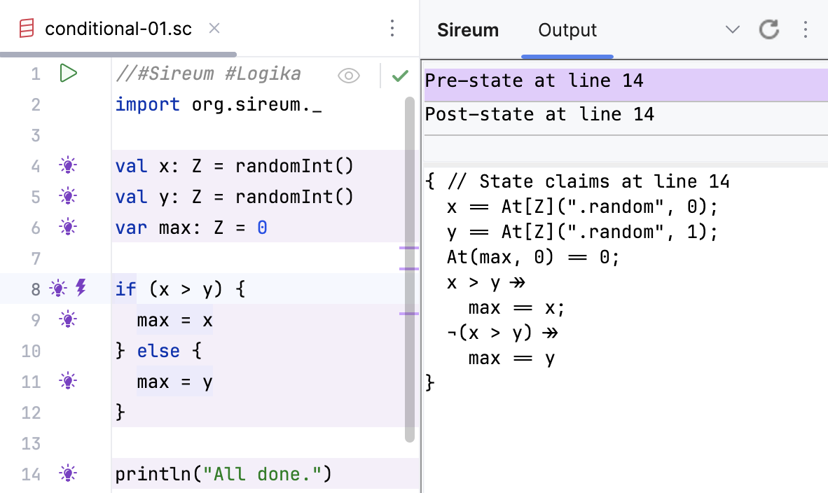
Conditionals: Step by Step
V-Know: B ->: F_{S} & !B -> F_{T}
At the end the conditional, conditional facts are added to the fact set – indicating the condition in which they hold

Slide 21
Method contracts

Slide 22

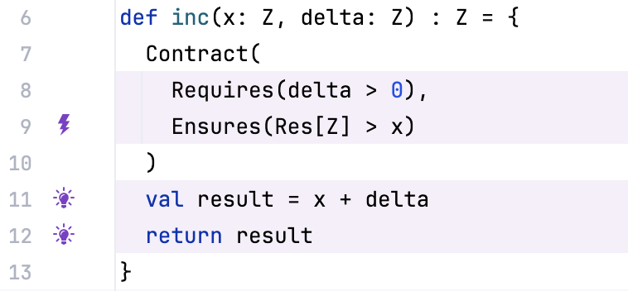
Method Contracts
Consider a method (a “service”) that returns a value that corresponding to the increment of x by a delta value…
Pre-condition:
…if we require all callers (“clients”) to supply a delta that is greater than 0
Post-condition:
…we can ensure that the result is strictly larger than x..

Slide 23
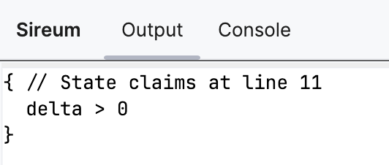
Service Verification
Logika verifies the method + contract independently of where it is called by a client (i.e., independently of its context)
Pre-condition:
…if we require all callers (“clients”) to supply a delta that is greater than 0
V-Know: delta > 0
Note: we can see the initial assumptions by viewing the facts at the beginning of the method body
When verifying the method against the contract, Logika begins by assuming that all constraints in the pre-condition hold.

Slide 24
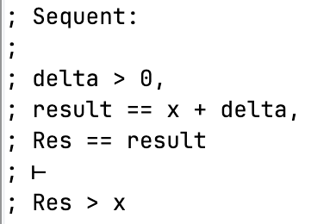
Service Verification
Logika verifies the method + contract independently of where it is called by a client (i.e., independently of its context)
Post-condition:
…we can ensure that the result is strictly larger than x..
Pre-condition
Method body
V-Prove: Res > x
Post-condition
Note: the post-condition bolt shows the verification condition (sequent) for that clause of the post-condition
The pre-condition facts together with the facts from the method body must imply the post-condition

Slide 25
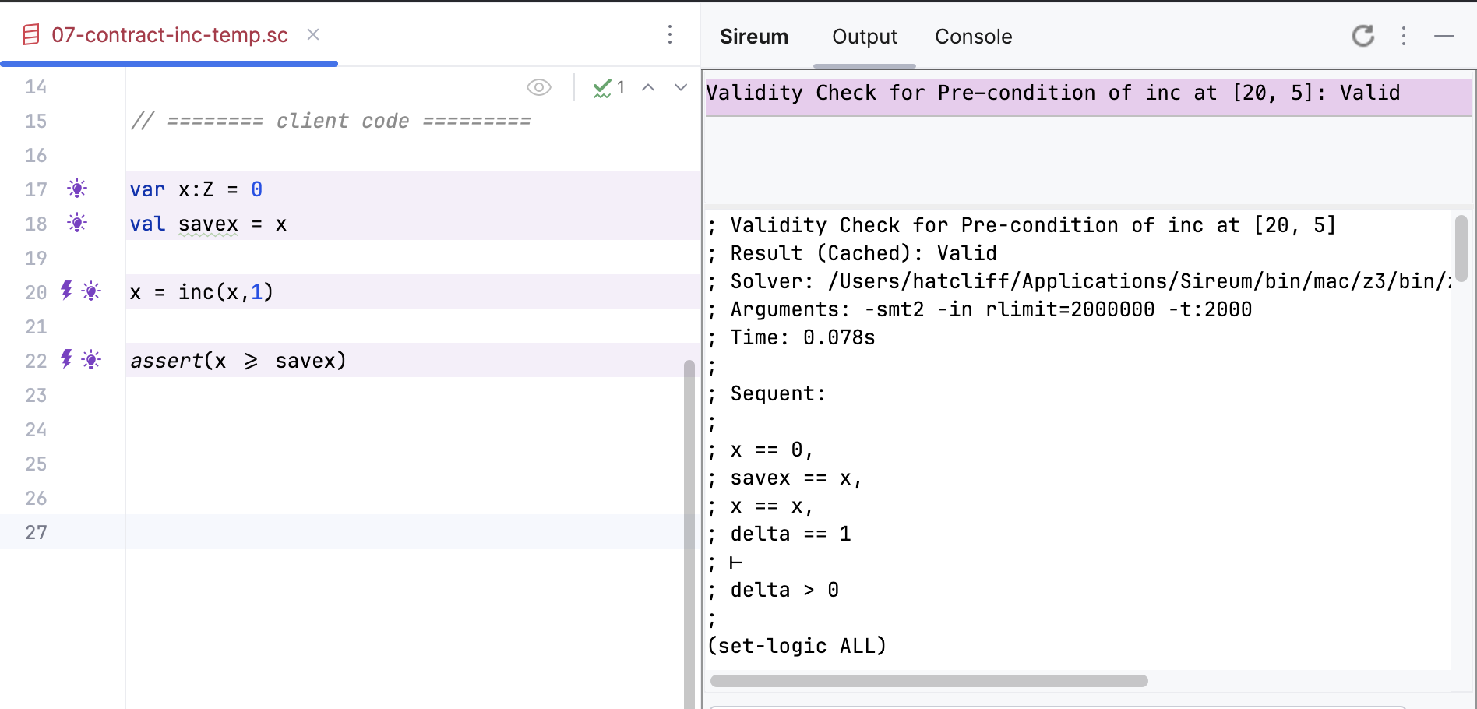
Client Verification
Logika checks that that the client satisfies the pre-condition.
After the call, the post-condition is added to the client’s fact set.
V-Prove: delta > 0
Client’s fact set at the point of service call
Fact for parameter binding
Pre-condition
Note: the bolt shows that Logika checks the pre-condition of the called service.

Slide 26
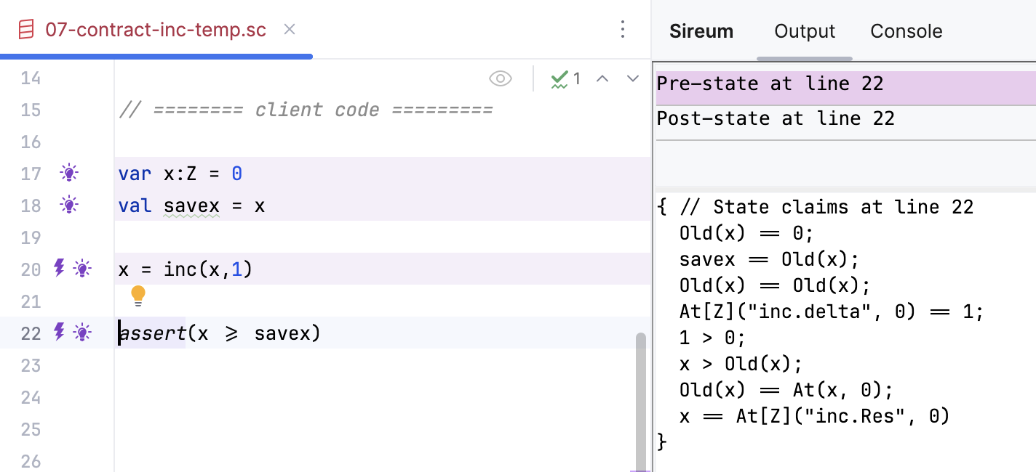
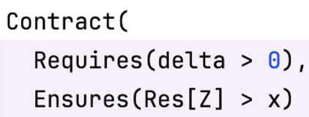
Client Verification
Logika checks that that the client satisfies the pre-condition.
After the call, the post-condition is added to the client’s fact set.
Representation of the post-condition is included in the client’s fact set after the call.
V-Know: Res[Z]> 0
Note: the bulb shows that the client’s fact set after the call includes the post-condition

Slide 27
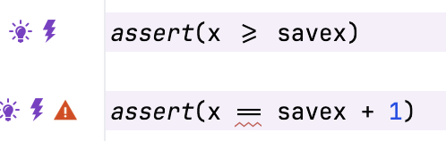
Client Verification
Note: The client only knows about what is declared on the service’s method/contract – it’s verification does not take into account the method’s implementation. This is the view we often take in software engineering: client’s should only depend on what is documented on a service’s API.
V-Know: Res[Z]> 0
Fails because the service contract only tells us that the result is greater than the argument.
This approach is known historically as “assume / guarantee” verification
It enables verification to scale since services and clients can be verified independently (e.g., in parallel)
Note: Logika has an alternate mode where it tunnels down into a method’s body (e.g., when a contract is not declared for the service)

Slide 28

Software Contracts
Service
V-Know:
Pre-condition added to fact set
Client
service can assume / rely on the fact that the pre-condition holds
V-Prove: Must prove that pre-condition holds
client guarantees that it establishes the pre-condition of the service
invocation of service
client can assume / rely on the fact that the service post-condition holds
service guarantees that the post-condition holds
V-Prove: Must prove that post-condition holds
V-Know: Post-condition added to the fact set

Slide 29
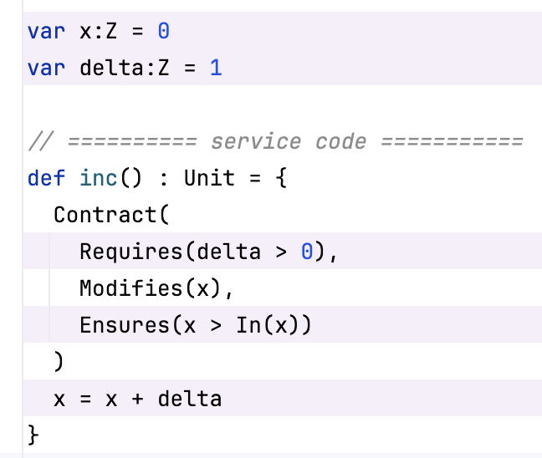
Dealing with Non-local Variables
Consider an alternate version of the method without parameters – but with non-local variables used…
Because we change the value of a variable the client may be using, we indicate that with a Modifies clause in the contract.
…all the client’s facts about x will be erased at the start of the call.
…when the call returns, the only thing known about x is what is stated in the post-condition

Slide 30
Referencing the Pre-State in Post-Condition
When input variables or parameters are modified, we use the In(…) annotation to refer to the input (pre-state) value. The non-annotated version refers to the post-state value.
Input (pre-state) value of x.
Output (post-state) value of x.

Slide 31
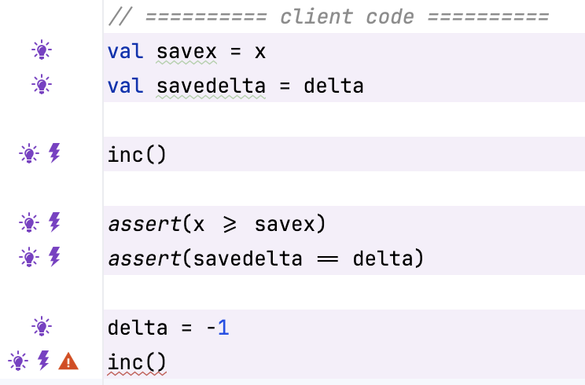
Non-local Variables – Client Code
When input variables or parameters are modified, we use the In(…) annotation to refer to the input (pre-state) value. The non-annotated version refers to the post-state value.
We can infer properties about the “output” variable x as before.
Because delta is declared as not modified, we can deduce that its value does not change.
In this call, the pre-condition on delta is violated.

Slide 32
Software Contracts
Service
V-Know:
Pre-condition added to fact set
Client
service can assume / rely on the fact that the pre-condition holds
V-Prove: Must prove that pre-condition holds
client guarantees that it establishes the pre-condition of the service
frame condition guarantees that service only performs changes mentioned in the post-condition -- it doesn’t interfere or mess with anything else.
invocation of service
client can assume / rely on the fact that the service post-condition holds
Can deduce that non-modified variables retain their values
service guarantees that the post-condition holds
V-Prove: Must prove that post-condition holds
V-Know: Post-condition added to the fact set

